Slide 1
T24 results and comparison to the preceding studies on CLIC prototype structures
May 17, 2011
T. Higo (KEK)

Slide 2
Topics
Processing as a whole
Typical BD appearance pattern
BD vs Eacc
BDR evolution
Comparison of BDR among structures
BDR vs pulse width or pulse heating
Dark current
Remembrance of preceding pulses
Thinking from double pulse operation
Following pulses without stopping
BD location

Slide 3
Prototype structures at Nextef
T18 TD18
TD18_quad
T24 TD24
TD24R05

Slide 4
Processing/operation as a whole
Number of breakdowns
T18 = 2500 BD / 4000 hrs
TD18 = 8000 BD / 4000 hrs
T24 = 1200 BD / 2000 hrs

Slide 5
T18_VG2.4_Disk #2
T18#2

Slide 6
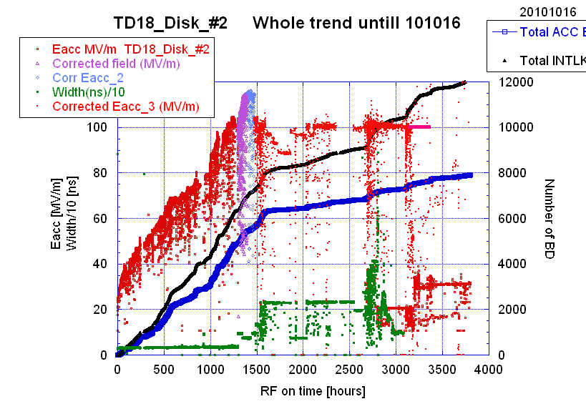
TD18

Slide 7
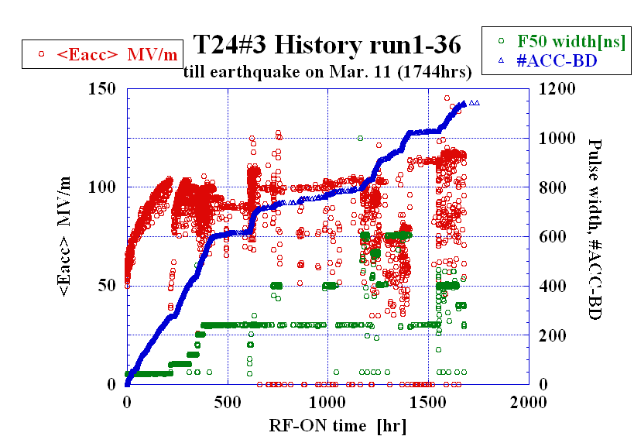
T24#3
Processed for 1744 hours.

Slide 8
Typical breakdown appearance pattern
Some breakdown triggers a series of following breakdowns.
After a while, it becomes stable, randomly appeared.
It needs usually more time to determine the BDR in a well-stable period. Sill we need better way of BDR evaluation.

Slide 9
Final run at 120MV/m
T24#3
Not statistically stable at all for especially a low BDR period.
Two categories!?
Severe BD & recovery
Stable regime
Well statistically developed
Ev31
Ev32
Ev30
Time of the final point is not real.
Ev26
Ev25
Regeme not-statistically random

Slide 10
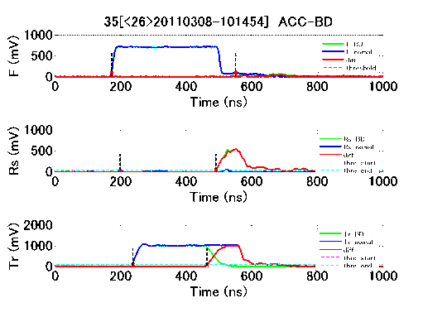
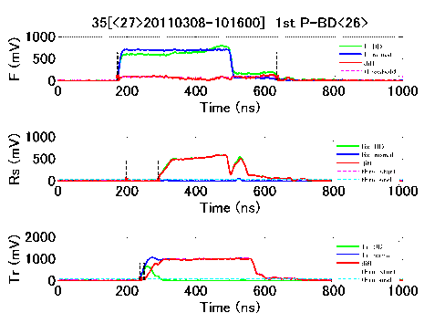
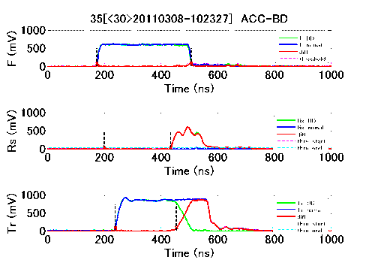
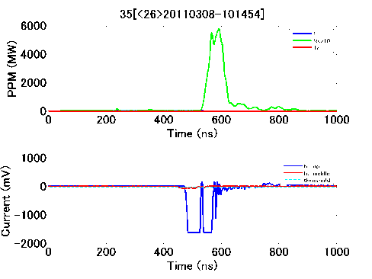
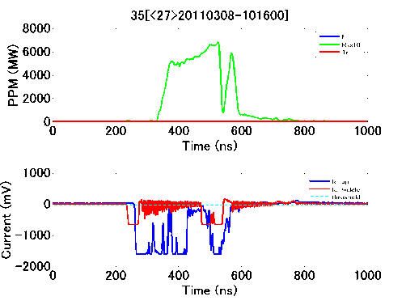
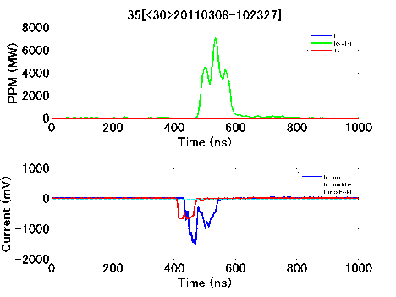
Typical ACC BD and following recovery process
T24
Run35
Each by 1 pulse
A few hundred pulses
Ev26
Ev27-29
Ev30
1st pulse BD
Recovery process
Next
ACC BD
ACC BD
Later in a pulse
From the beginning of a pulse
Again at later in a pulse

Slide 11
T24#3 Run16 goal 110MV/m at 252nsec
BDR vs time

Slide 12
TD18_#2 at 252 ns
TD18_Disk_#2 BDR~ 1.3 x 10⁻⁵ /pulse/m]
during Run 51&52 (60MW, 252ns)
as of the total RF-ON period of 2255 hours
# BD
BDR
10^-6 /pulse/m
Still decreasing in a logarithmic time scale BDR ~ t^-0.38

Slide 13
BDR vs Eacc
Exponential slope at 100 MV/m
  for 10MV/m
  T18 X10
  TD18 X20
  T24 X10
Power index “n” as E_{acc}^{n}
  T18 n= 26
  TD18 n=25-29
  T18 n=22

Slide 14
Breakdown rate
T18#2

Slide 15
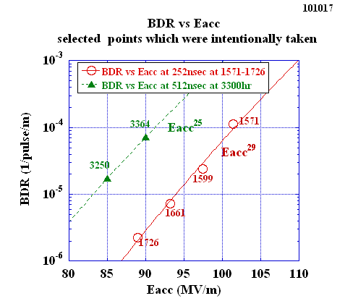
Relevant data points of BDR vs Eacc
TD18
Steep rise as Eacc, 10 times per 10 MV/m, less steep than T18

Slide 16
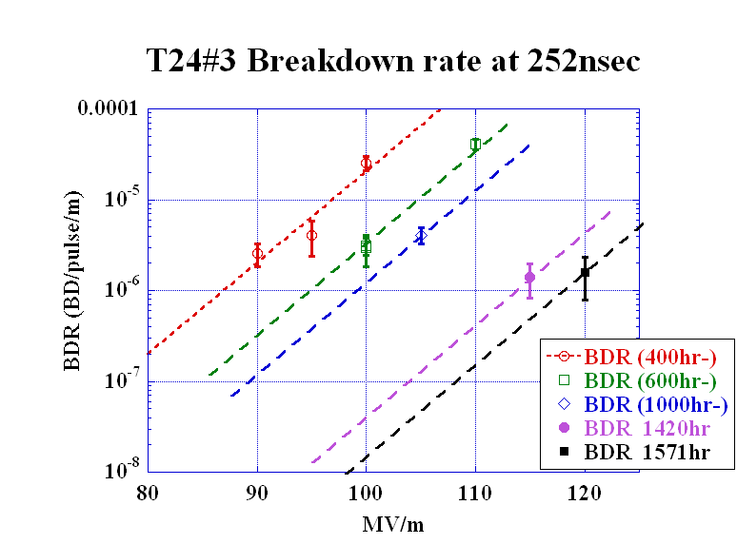
T24#3 BDR evolution at 252ns
T24
Lines are assuming the same exponential slope as that at 400hr

Slide 17
BDR evolution nominal at 100MV/m 252ns
Exponential decrease
  T18 TD18 T24
  400hrs 186hrs
Power index “n” as (elapsed time)^{-x}
  T18 TD18 T24
  - 4.3

Slide 18
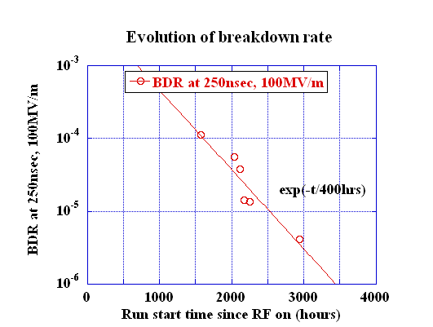
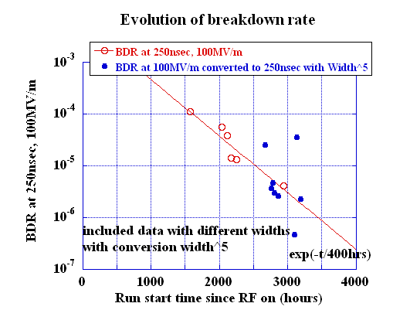
TD18_#2 Evolution of breakdown rate
TD18

Slide 19
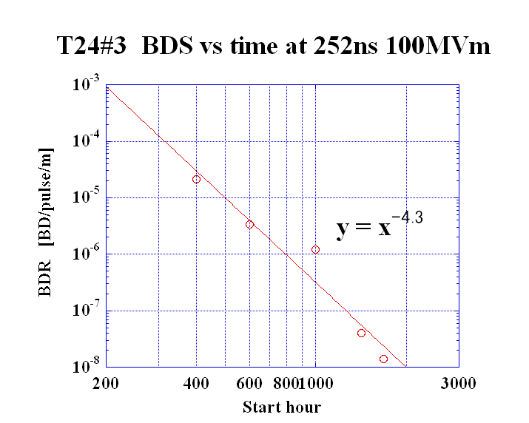
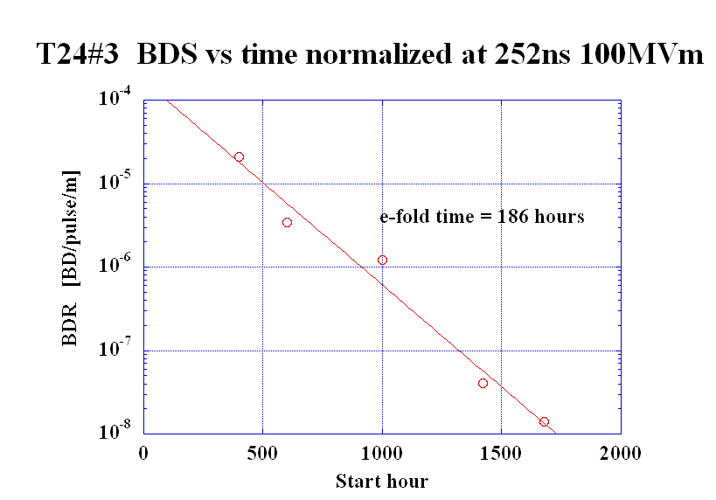
T24#3
BDR evolution at 252ns normalized 100MV/m
T24
Assuming the same exponential slope as that at 400hr

Slide 20
Comparison of BDR among structures
Present status
Comparison of BDR vs Eacc is just the base for feasibility evaluation.
It is not easy to evaluate < 10^-7.
And it is time dependent.
What is the best parameter to characterize?
No more than demandnig more understanding of BD (and BD trigger) mechanism.

Slide 21
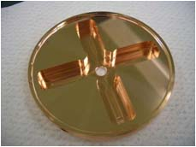
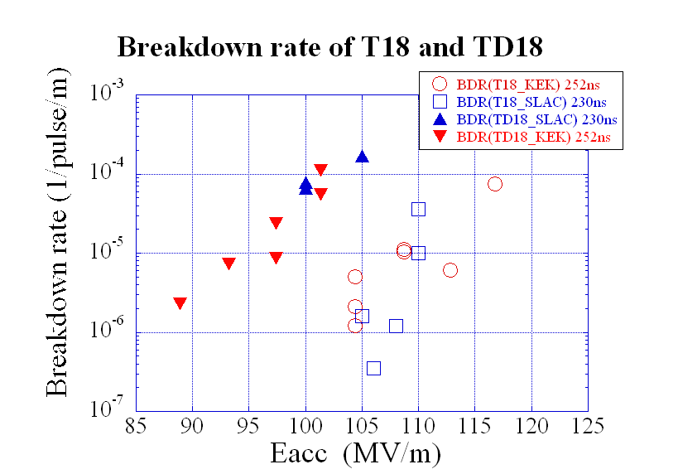
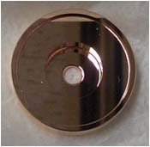
Comparison of BDR in
T18, TD18 and T24
400hrs
TD18
T24
1677hrs
T18
T18 T24
Notes:
Damped 放電頻度 約100倍
温度上昇か？？

Slide 22
BDR vs pulse width or pulse heating
It is evident that BDT is a steep function of pulse heating.
But not yet well understood when comparing various structures, and even in various stages of a structure.

Slide 23
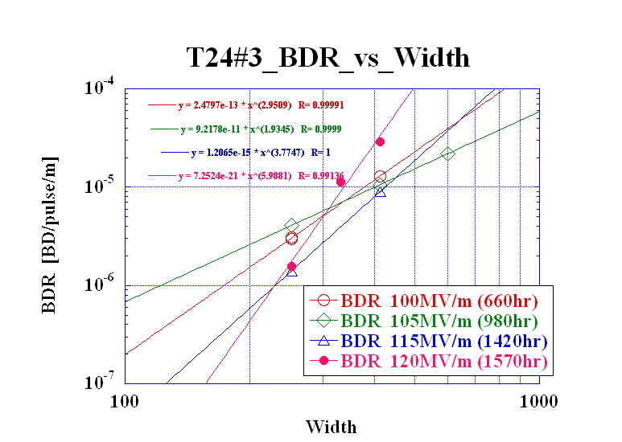
T24#3 BDR vs width in various stages
T24#3

Slide 24
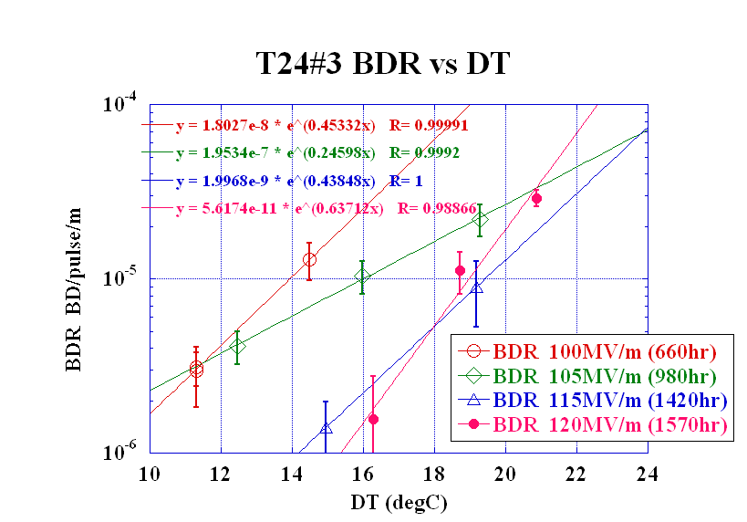
T24#3 BDR vs Pulse heating
T24#3
at 105MV/m
Final at 120MV/m
BDR scales as exponential to pulse heating, though BDR changes as processing and the functional form is not easy to conclude.

Slide 25
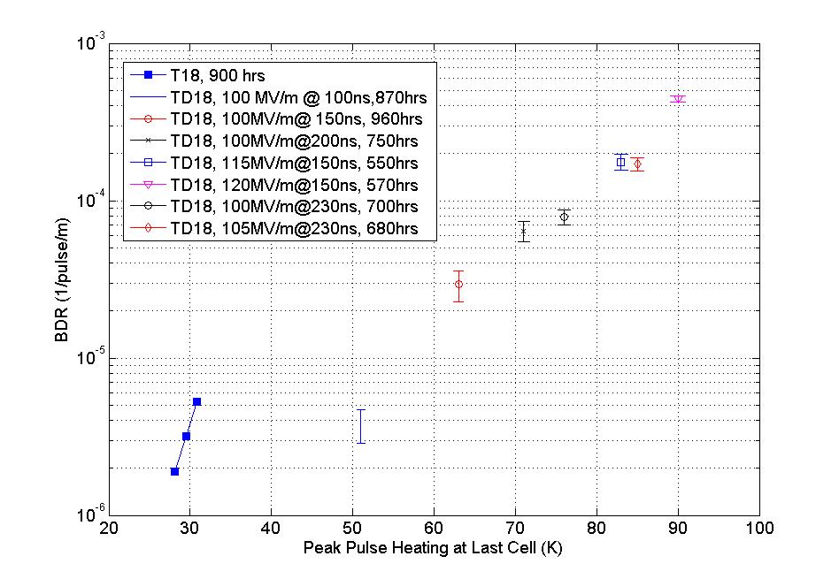
BDR vs ΔT
TD18 based on Faya Wang
BDR
BDR varies exponential to ΔT.
The amount seems very different between T18(SLAC) and T24(KEK).
Damped
Undamped
T24#3 at 120MV/m
ΔT
Notes:
温度上昇をパラメータとすると
放電頻度が統一的に見えてきた

Slide 26
Dark current

Slide 27
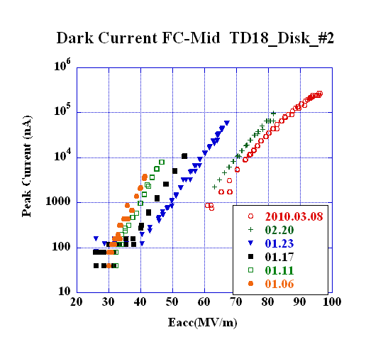
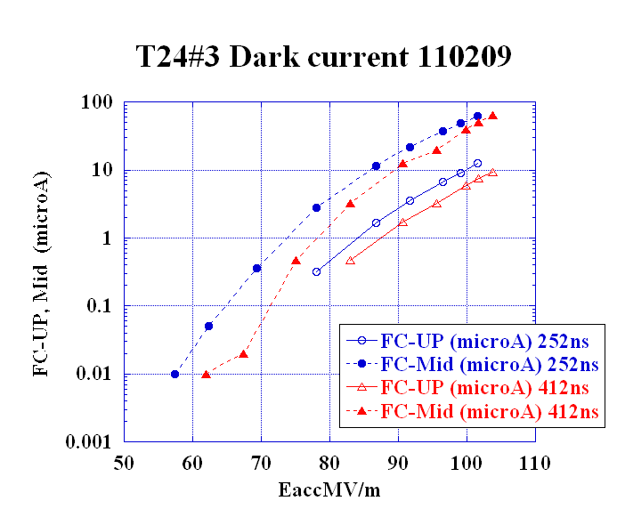
Amount and reached level
T18_Disk
TD18_Disk
T24_Disk
Eacc for peak dark current of 10 μA
90MV/m 70MV/m 85MV/m

Slide 28
Field enhancement factor as of 090515
T18#2
No big change in β during
RF ON = 2300 – 2900 hrs
β ~ 36—38
Following the formula and parameters of the following page

Slide 29
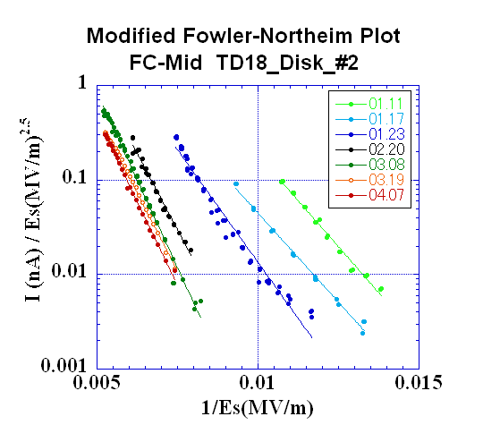
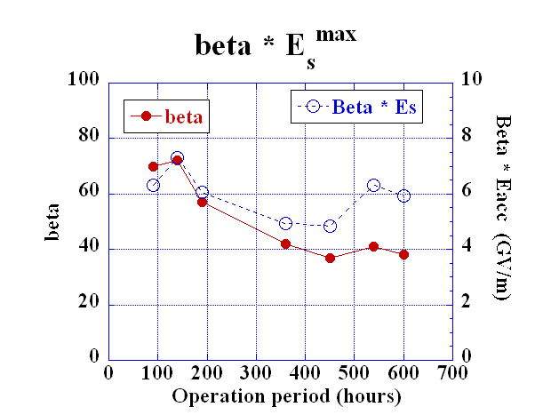
TD18
IPAC10
Evolution of dark current till early April
in TD18_Disk
3100 hr
Dark current reduced by three order of magnitude.
It followed roughly modified F-N formula.
The β reduced from 70 to 40 in its initial stage of processing
keeping β * E_{s}^{max} ~ 5~7 GV/m
but became larger to 55 at the later stage.

Slide 30
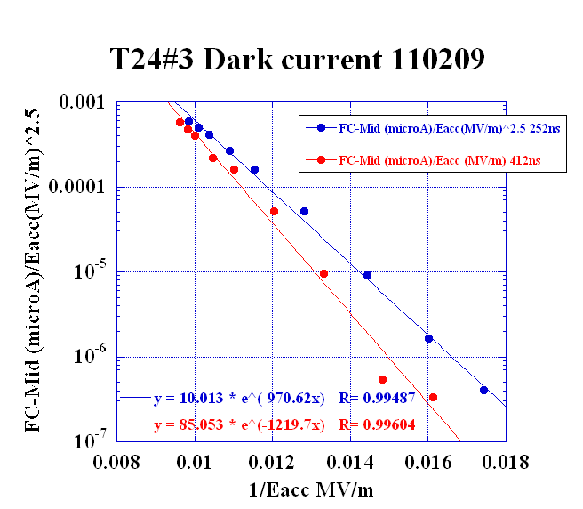
Fitting including low current data points
T24#3
β=33 (252ns)
Beta seem small
β = 26—33
at RF ON = 1000 hrs
β=26 (412ns)

Slide 31
Comparison of beta values
 | T18 | TD18 | T24
Meas. at RF ON(hrs) | 2300 – 2900 | 100 – 600 → 3200 | 1000
β | 36 – 38 | 70 → 40 → 55 | 26 – 33
Seems good to compare these values.
Higher beta in TD18? How it changes as time?
Better to monitor systematically.

Slide 32
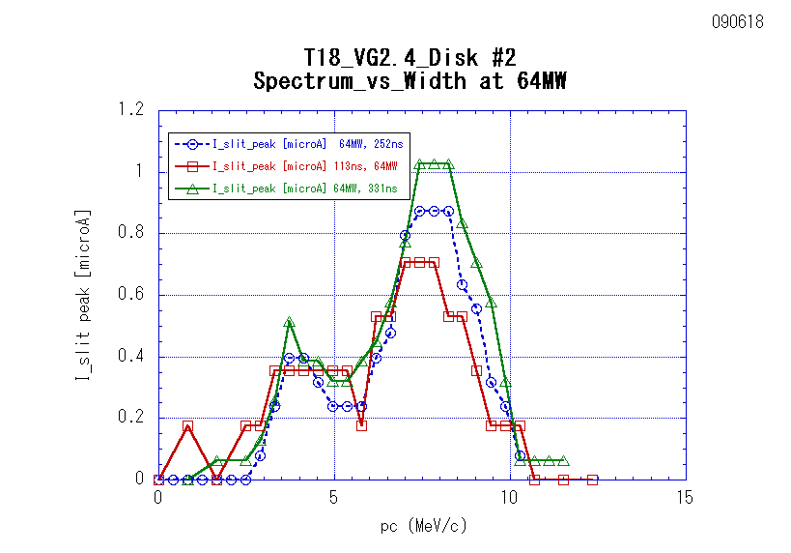
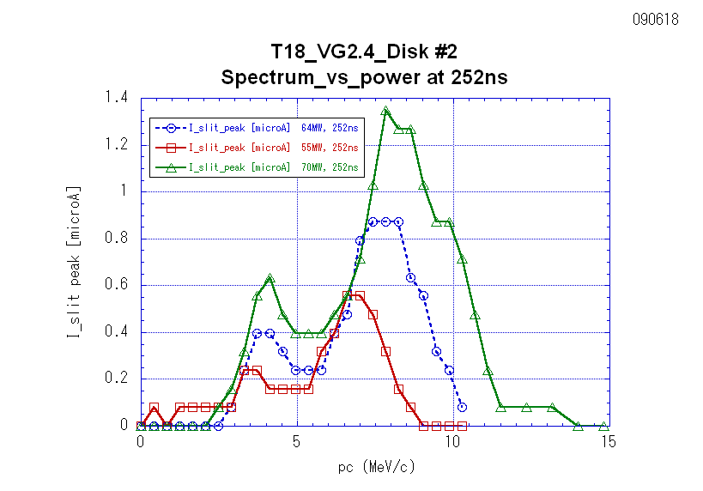
Dark current spectra
T18#2
Different widths
Different acc field levels

Slide 33
TD18 spectrum is missing.
Our fault!
TD18
Simply enough!
It should be measured!

Slide 34
T24#3 Dark current spectra
Meas. 25 Feb., 2011 @ 1400 hours after processing start
T24#3

Slide 35
Dark current
Dark current gives a measure on HG performance
  In beta
  In its amount
Dark current contains many hints
  field emission site
  beta as a whole and possibly local beta
  Even though it is the result of the whole area with a limited acceptance
We want to improve the monitoring
  As the processing proceeds, especially at the beginning

Slide 36
Remembrance of the preceding pulse?
Is the breakdown trigger influenced by anything from the preceding pulse or from the general situation of the period?

Slide 37
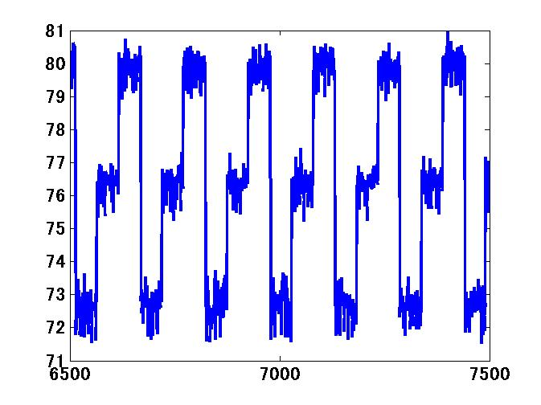
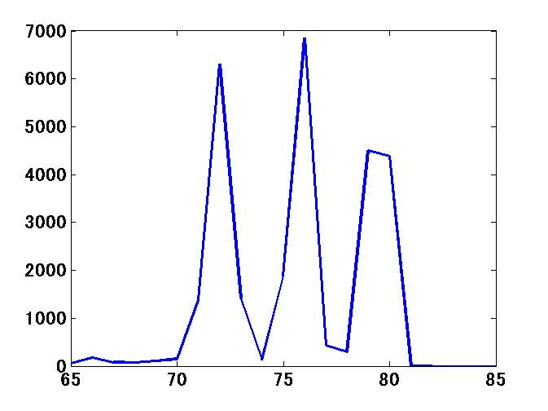
Run 98 switching among three power levels for 46.2 hours
TD18
90 – 95 – 100 MV/m
Switching among three power levels in each 50 pulses.

Slide 38
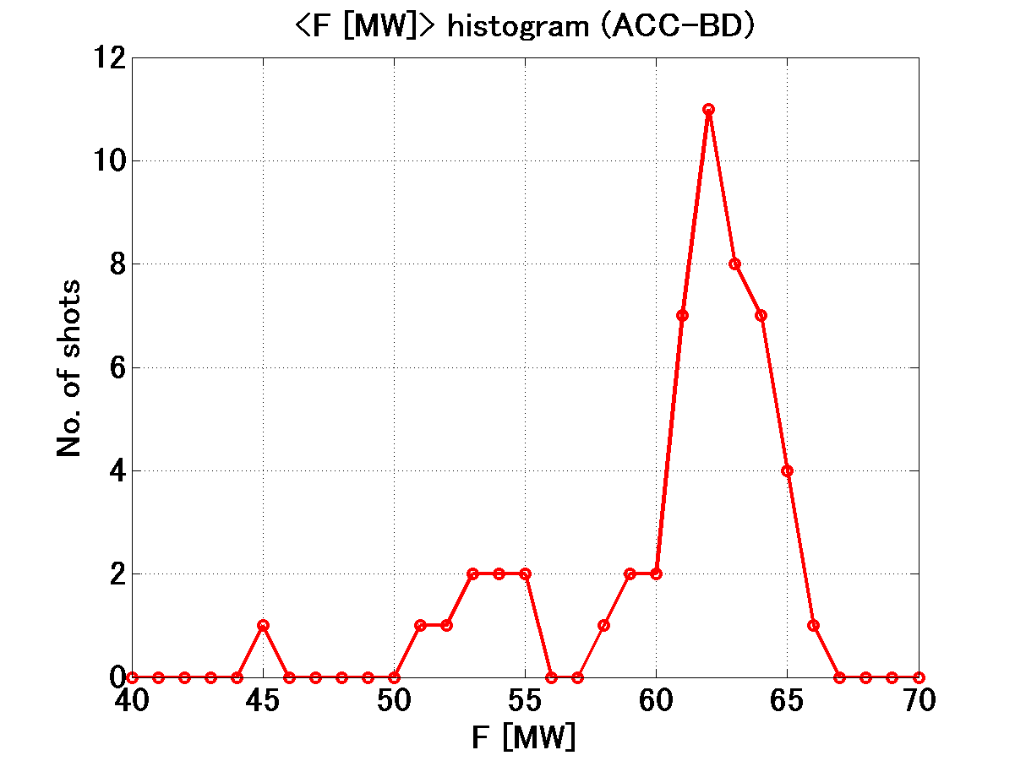
Comparison to the usual BDR data
TD18
Run 98
43
8
1
3.3*10⁻⁶ / 2.6*10⁻⁵ / 1.4*10⁻⁴
[BD/pulse/m]
Data points from jumping among three levels
BDR is determined by the power level of the very pulse.

Slide 39
The remembrance of the preceding pulses, 50 – 100 pulses ahead, is not kept.
We need to refrain the same experiment with pulse-to-pulse switching to see whether the remembrance is kept from the previous pulse.

Slide 40
Thinking from double pulse study
What about the remembrance very close to the last pulse separated by 10 – 200 nsec period?

Slide 41
BDR: measured and instantaneous
f(E_{acc}) = BDR depending on E_{acc}
g(t) = instantaneous BDR within a pulse
h(ΔT_{p}) = BD potential factor determined by the integrated effect of such as pulse heating of many pulses before the BD pulse
We thought that the double pulse study would give us the clue.

Slide 42
Features investigated by double pulse operation
Period
Width
200ns
LE
5ns
TE
5ns
200 + 10 + 200
200 + 210 + 200
FG set value
Period=210ns
Width=200ns
FG set value
Period=410ns
Width=200ns
Double (200+10+200)
= Single (410ns eq.)
in TD18 Run 71
(30 June – 1 July ---)
Double (200+210+200)
= Single (2000 or 400ns eq.??)
in TD18 Run 72, 73, 74, 89, …

Slide 43
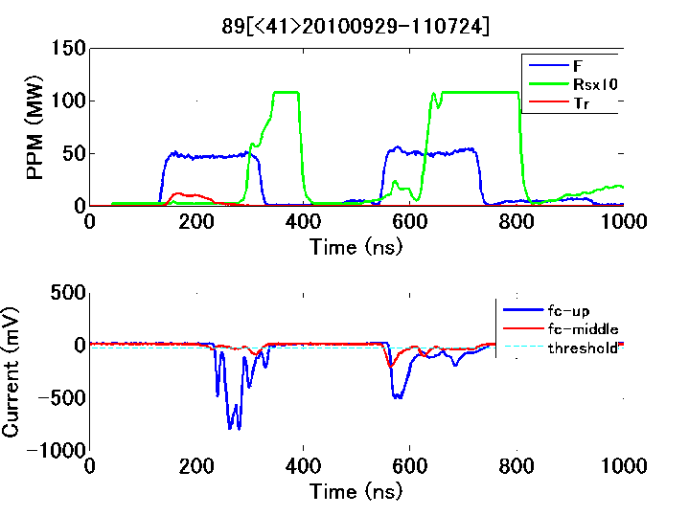
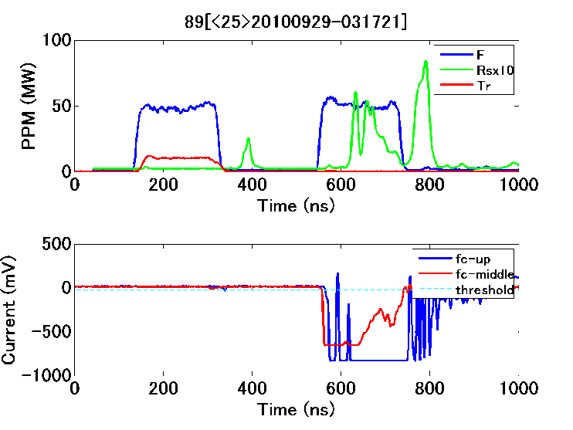
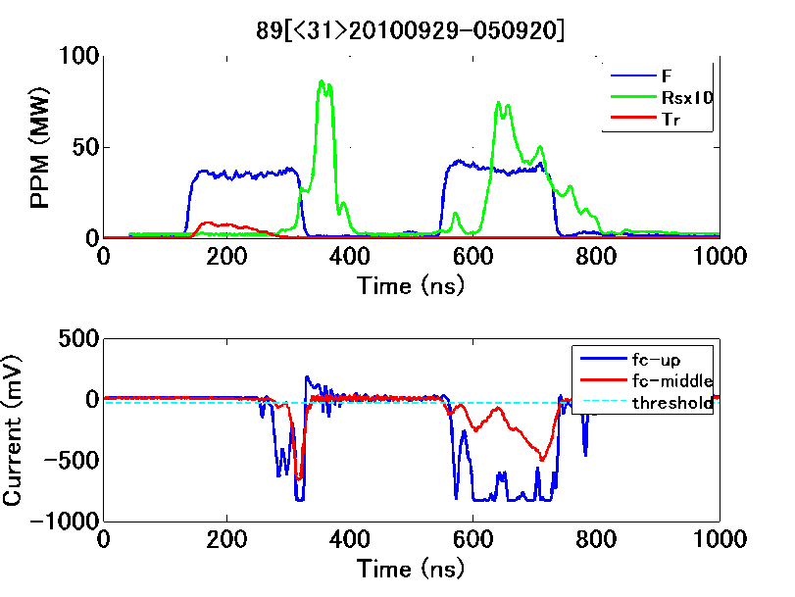
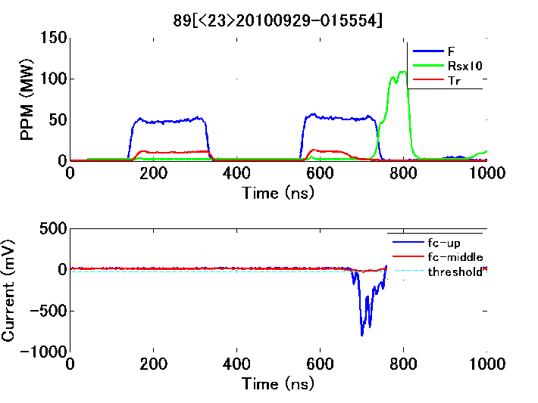
TD18 Run 89
Well separated double pulse at 90 MV/m
TD18

Slide 44
Run 25&26 T24#3 BDR double pulse at 110MV/m
T24#3
Run25=200+10+200
Run26=200+200+200
Guide line slope :
BDR_former = 2.4*10^-6
BDR_latter = 3.7*10^-6
Guide line slope :
BDR_former = 3.2*10^-6
BDR_latter = 4.0*10^-6

Slide 45
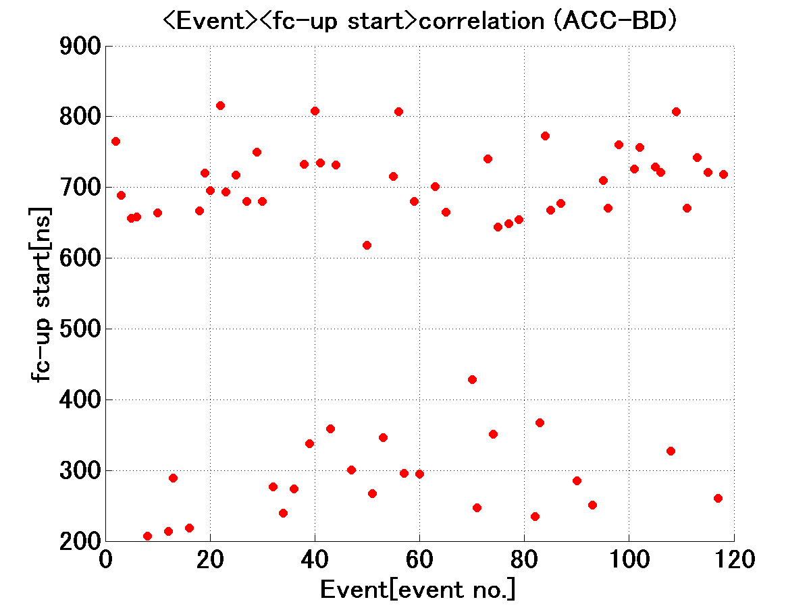
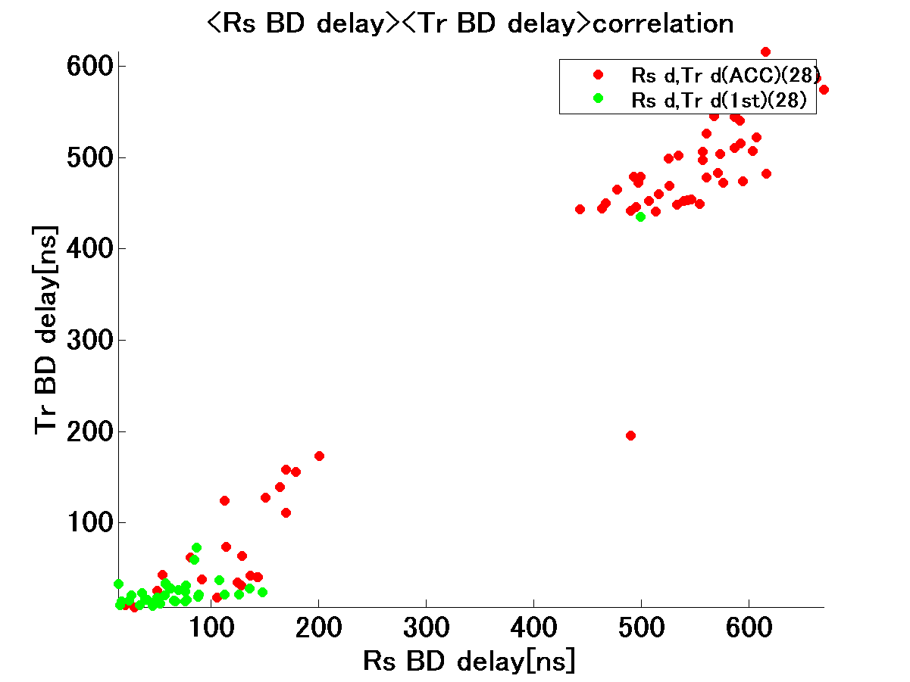
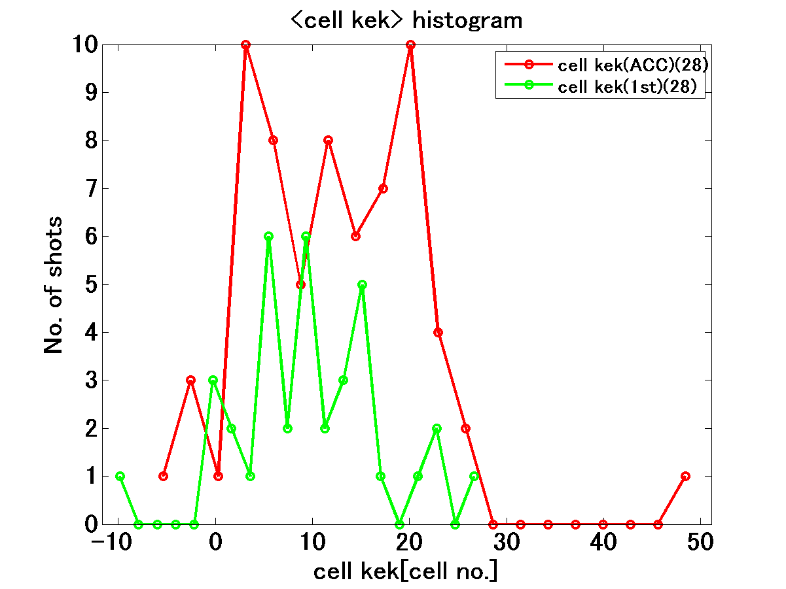
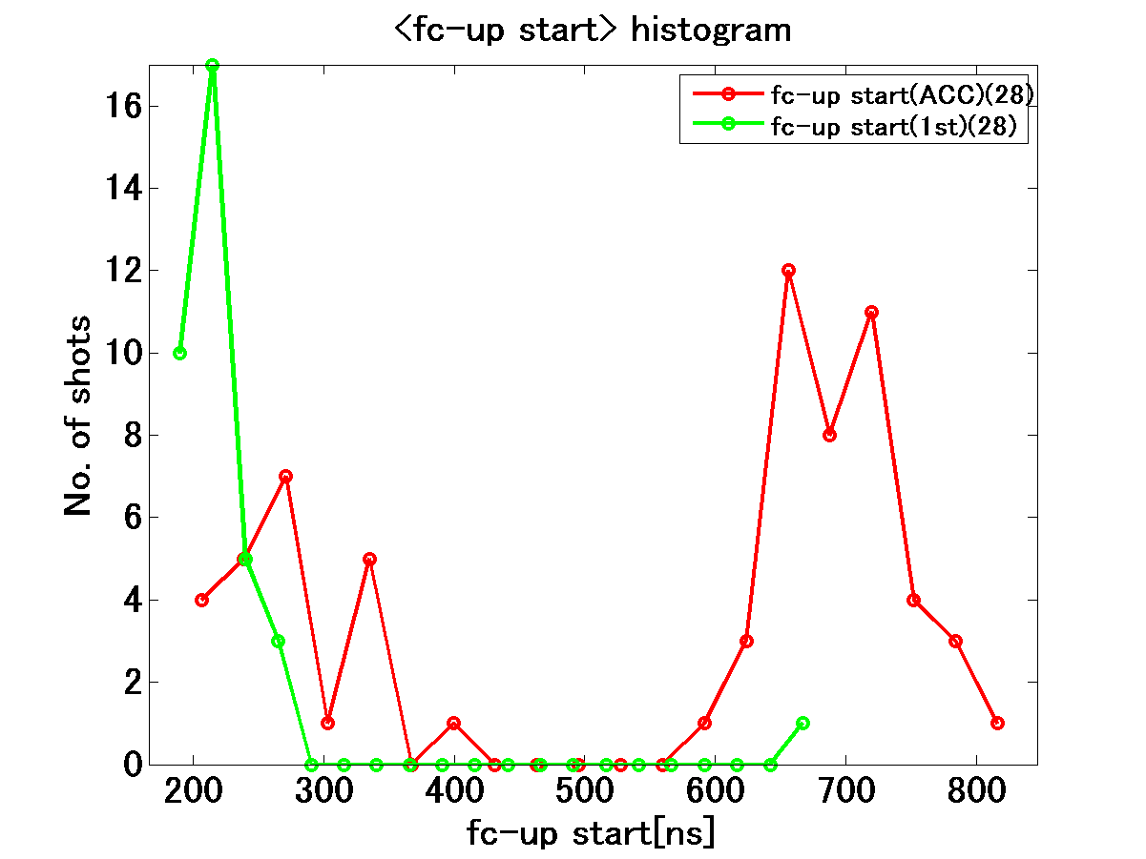
Run28: 200+200+200
T24#3
ACC-BD
ACC-BD
First-pulse BD
First-pulse BD

Slide 46
Result of double pulse study
T24#3
The BDR becomes saturating after initial a few tens of hours.
BDR of latter pulse is a little higher than that of former pulse, but at most within a factor 2.
Former pulse BD always triggers latter pulse BD.
The breakdown timing within a pulse distributes uniformly in the pulse.
First-pulse BD after a BD mostly starts from the beginning of the former pulse.

Slide 47
Trigger for the breakdown
T24#3
Pulse heating at 100MV/m
  200ns (ΔT=10degC) → 400ns(ΔT=13-14degC)
Then from width dependence
  BDR exponential rise as ΔT_{p} (SLAC TD18)
  ΔT_{p}=3degC →h(ΔT_{p}) x10
But double pulse result
  BDR of latter pulse = at most x2
  It seems g(t) rises moderate even if rises
This result supports
  BDR is mostly determined by non-instantaneous mechanism.
  i.e. no memory from the preceding pulse sepaated by 10 – 200 nsec.

Slide 48
Following pulses without stopping
How the structure changes after “BIG” breakdown?
The probability of breakdown is extremely high, but the breakdown does not always happen.
The probability of the breakdown rapidly decreases as number of pulses.
Structure surely remembers the BD.

Slide 49
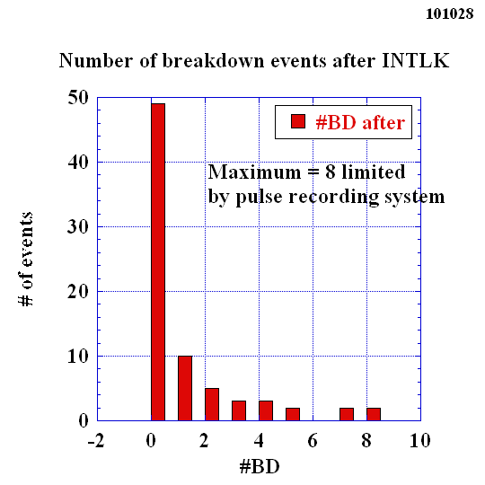
Run 100 at 100 MV/m level
Behavior of eight pulses after BD
TD18
More than 50% of breakdowns are not accompanied by any consecutive breakdowns.
Some are followed by breakdowns.
Correlation between number of consecutive breakdowns and the hardness of the initial breakdown should be evaluated.

Slide 50
BD location

Slide 51
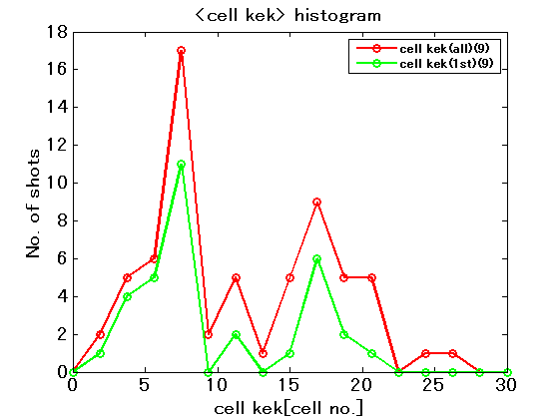
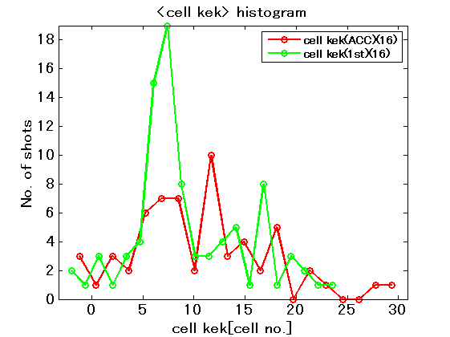
T24#3 BD location
T24#3
Run 9 RF-ON=400-430 hrs
100MV/m at 252ns just after reaching
Run 16 RF-ON=620-660 hrs
During ramping to
110MV/m at 252ns

Slide 52
BD location
Analysis program for the BD localization by RF timing has almost been developed.
KEK needs careful and through analysis of BD location, back to T18 and TD18.
This I was reminded by the SEM views of T18 and TD18 shown by CERN, the distribution of the arc spots and the high magnetic field spots along the structures.
We have in mind but not yet done well.

Slide 53
Conclusion
Systematic understanding applicable to all of the structures is not established at all.
We should acquire more data systematically.
We should make complementally studies with simple setups depicting each a single change than reference to look at the relevant mechanism that appeared in the prototype structures.
Theoretical studies are welcome in understanding and finding the strategy.

Slide 54
Additional materials

Slide 55
Deduction of the field enhancement factor
Fitting of modified F-N curve
Assuming Es/Eacc=1.95 for T24
φ(Cu)=4.52eV

Slide 56
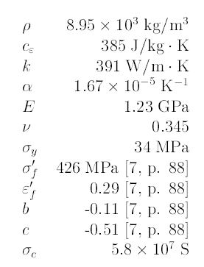



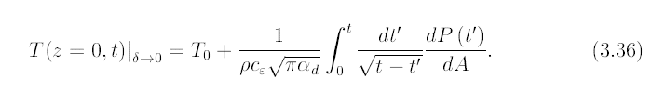
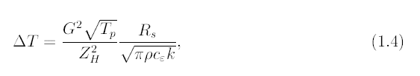
Pritzkau thesis

Slide 57
Study with double-pulse operation
Temperature rise was calculated based on Pritzkau thesis formula.
For 200nsX2 double pulse, very little difference exists in the latter pulses with different off-periods from 0 to 200ns.
Big temperature difference exists only between former pulse and latter pulse
  T24: Former=10.1C vs Latter=13.3 ~14.3degC
  TD18: Former=45 vs Latter=60~63C.
Let us compare the BDR between former and latter pulse!!

Slide 58
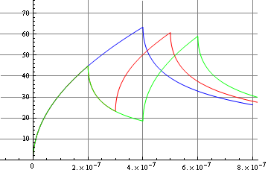
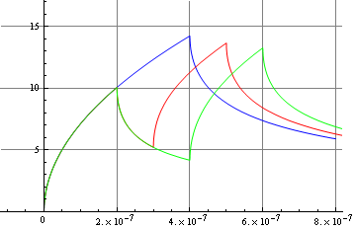
Double-pulse temperature rise at unloaded gradient of 100MV/m
Hs=0.485MA/m at the last cell of TD18#3
Hs=0.23MA/m at the last cell of T24#2
magnetic field= 0.485 MA/m
At end of full pulse 0.4 microsec temp= 63.3727 degC
At end of first pulse 0.2 microsec temp= 44.8112 degC
At beginniing of second pulse 0.3 microsec temp= 23.196 degC
At end of second pulse 0.5 microsec temp= 60.7817 degC
At end of first pulse 0.2 microsec temp= 44.8112 degC
At beginniing of second pulse 0.4 microsec temp= 18.5614 degC
At end of second pulse 0.6 microsec temp= 59.0539 degC
magnetic field= 0.23 MA/m
At end of full pulse 0.4 microsec temp= 14.2519 degC
At end of first pulse 0.2 microsec temp= 10.0776 degC
At beginniing of second pulse 0.3 microsec temp= 5.21657 degC
At end of second pulse 0.5 microsec temp= 13.6693 degC
At end of first pulse 0.2 microsec temp= 10.0776 degC
At beginniing of second pulse 0.4 microsec temp= 4.1743 degC
At end of second pulse 0.6 microsec temp= 13.2807 degC
No significant difference in pulse heating temperatures among latter pulses, only 6%, but significant difference between former and latter, by 40%.

